Slide 1
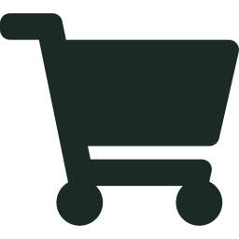
Fresh Mart
Grocery Shop Management System
OOPS Lab Mini Project
Submitted to: Dr. Sakshi Ranjan
Submitted by:
R025 Anmol Jain
R028 Thakarshi Jayandhan
R031 Harsh Joshi
Notes:
Introduce the team and the project (about 1 minute). Fresh Mart is a grocery shop system written in Java. It started as a console program and now also runs as a website, so a customer can browse products, fill a cart and pay.

Slide 2
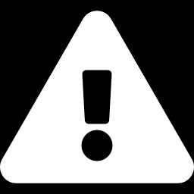
Manual billing causes mistakes
Wrong totals
Stock mismatch
Slow billing
Totals are added up by hand and go wrong
Stock records do not match the shelf
Billing is slow and hard to repeat
Notes:
About 1 minute. Many small shops still bill by hand, which leads to wrong totals, stock records that do not match the shelf, and slow service. The next slides show how the system solves each of these.

Slide 3
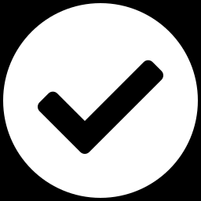
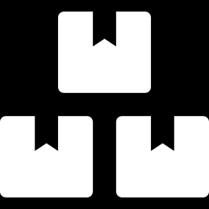
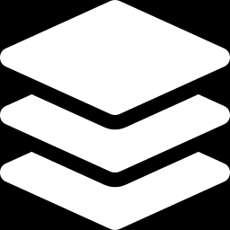
Project objectives
Automate billing
Keep stock accurate
The cart totals the bill with no manual sums
Stock is checked before and reduced after each purchase
Apply OOP concepts
Abstraction, inheritance, polymorphism and exceptions
Scope: products, cart, checkout and error handling. Data is kept in memory.
Notes:
About 1 minute. Four goals: automate the bill, keep stock accurate, apply the OOP concepts from the course, and offer both a console and a website. The scope is products, cart, checkout and error handling. Data lives in memory, so it resets when the program restarts.

Slide 4
How a purchase works
1
2
3
4
5
View products
Pick item and quantity
Validate
Add to cart
Checkout
Browse the 14-item catalogue
Choose what to buy
Check the number and the stock
The bill total updates
Stock is reduced, payment confirmed
If a check fails, the customer sees a clear message and the program keeps running.
Notes:
About 1.5 minutes. Walk through the five steps. Step 3 is the important one: the quantity must be a valid number, the product must be in stock, and the requested amount must be available. Otherwise an error message is shown.

Slide 5
Classes and their roles
Class | Role
Purchasable | Interface: price, availability and purchase()
Product | Abstract base class with name, price and quantity
FoodItem, BeverageItem, NonFoodItem | Subclasses with their own fields and details
Cart and CartItem | Holds the cart lines, totals the bill, deducts stock
Customer | The shopper, who owns one Cart
GroceryStore | Loads 14 products and runs the console menu
GroceryWeb | Serves the web page and the /api routes
Notes:
About 1.5 minutes. Go down the table quickly. Stress that Purchasable and Product give the structure, the three subclasses add detail, Cart and Customer model the shopper, and GroceryStore and GroceryWeb are the two ways in: console and website.

Slide 6
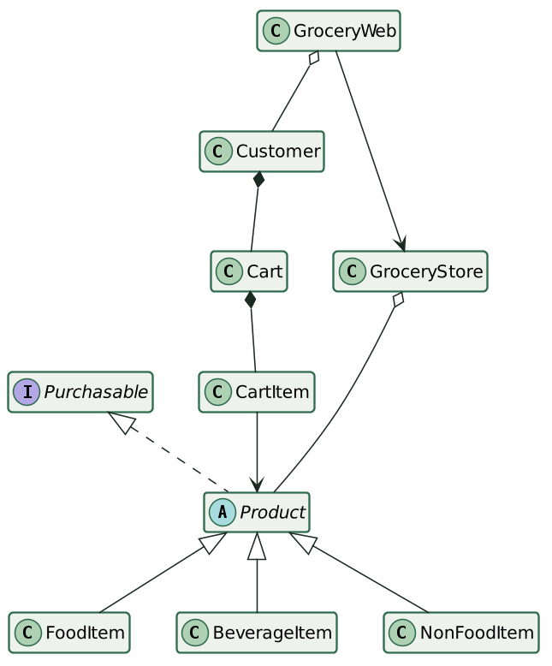
Class design
Inheritance: Product to its three subclasses
Realization: Product implements Purchasable
Composition: Customer owns a Cart; Cart owns its CartItems
Aggregation: GroceryStore holds the Products
Association: CartItem refers to a Product
Full UML set on GitHub: [repository link]/uml
Notes:
About 1.5 minutes. The diagram shows the main classes. Point out inheritance from Product, the Customer-Cart composition, and the GroceryStore holding products. The full UML document with class, use case, sequence, activity and deployment diagrams is on GitHub.

Slide 7
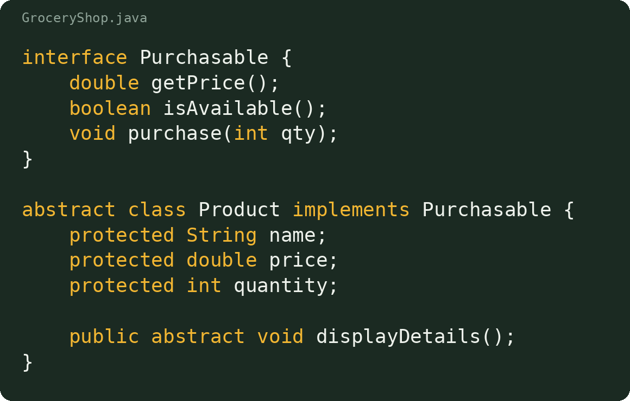
Abstraction in code
Purchasable lists what anything on sale must do
Product is abstract, so it cannot be created directly
Shared fields are protected for the subclasses
displayDetails() forces every subclass to describe itself
Notes:
About 1 minute. Start with the interface: any purchasable thing must give a price, say if it is available, and be purchased. Product implements it and holds the shared fields. Because Product is abstract, only its subclasses can be created.

Slide 8
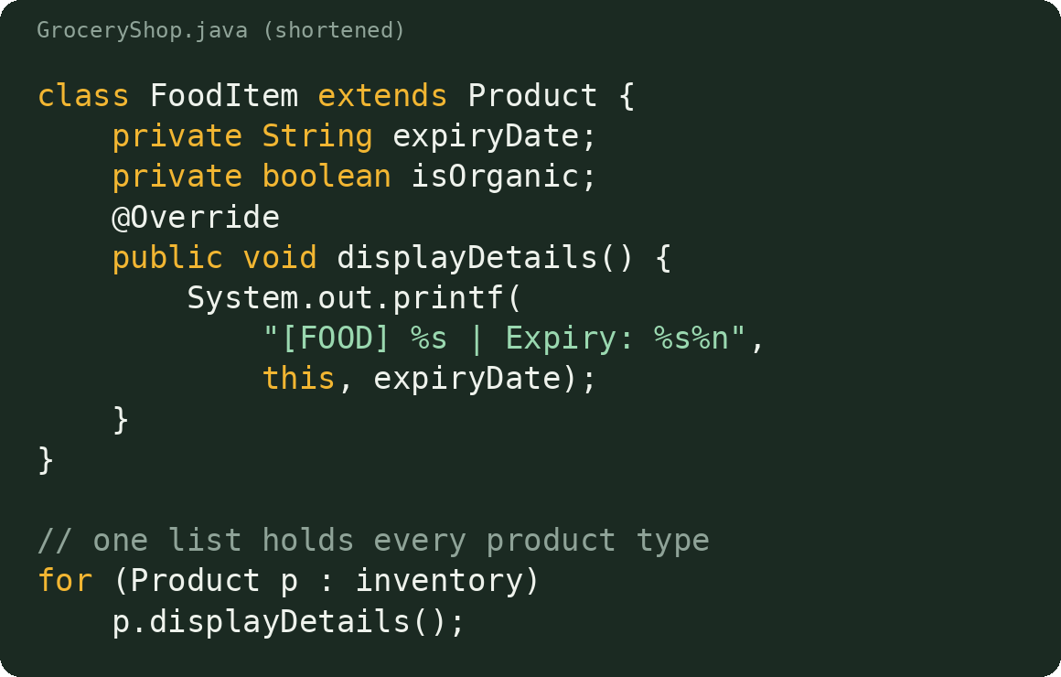
Inheritance and polymorphism
FoodItem, BeverageItem and NonFoodItem all extend Product
Each one adds its own fields and overrides displayDetails()
The store keeps a single List of Product
At runtime Java calls the right version for each object
Notes:
About 1.5 minutes. Show FoodItem as the example; the other two follow the same pattern with different fields. The loop at the bottom is the key: one list, one call, and each object prints itself in its own way. That is dynamic method binding.

Slide 9
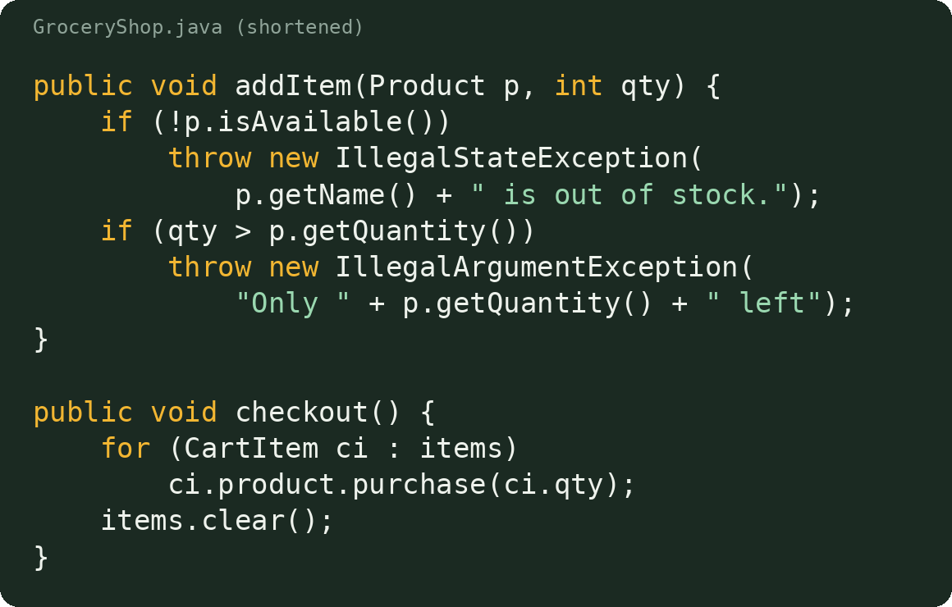
Cart: add and checkout
Cart holds a List of CartItem lines: a product and a quantity
addItem() refuses out-of-stock products and too-large quantities
getTotal() sums price times quantity with a stream
checkout() deducts stock for each line, then empties the cart
Notes:
About 1.5 minutes. The cart is where billing happens. addItem checks availability and stock before adding, and merges repeat additions. getTotal uses a stream to add up price times quantity. checkout reduces stock through purchase and then clears the cart.

Slide 10
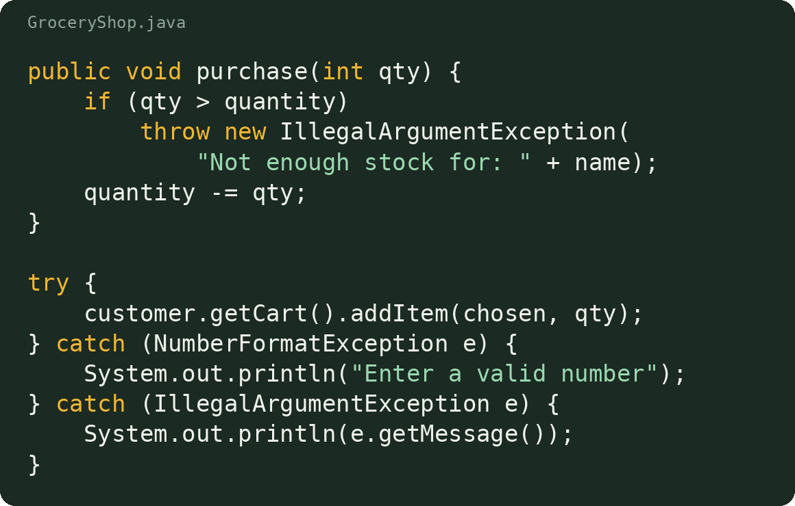
Exception handling in code
Product.purchase() refuses to take stock below zero
The menu code wraps cart actions in try-catch
Bad numbers and stock errors show a message
The program keeps running instead of crashing
Notes:
About 1.5 minutes. Errors are thrown where they are detected, in purchase and addItem, and caught where the user types, in the menu. Typing letters triggers NumberFormatException, and asking for too much stock triggers IllegalArgumentException. Either way the user sees a message and the program continues.

Slide 11
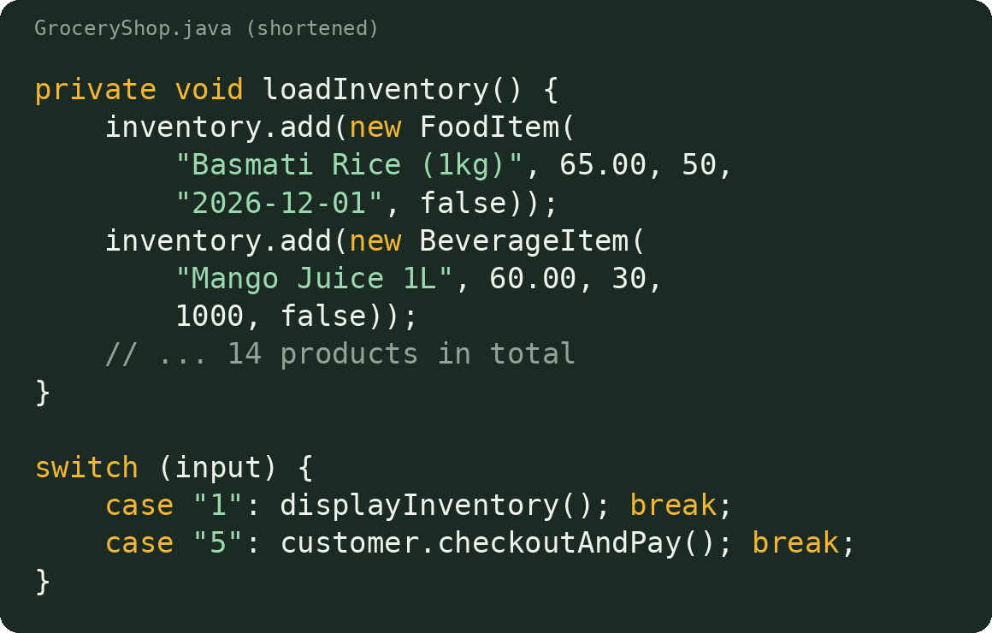
Inventory and the menu
GroceryStore loads 14 products into a List of Product
run() shows a menu and reads the choice in a loop
A switch sends each choice to the right method
Customer owns a Cart, and checkoutAndPay() prints the bill
Notes:
About 1 minute. GroceryStore is the controller. It fills the inventory once, then loops: show the menu, read a choice, and use a switch to call the right method. The Customer owns the Cart, so checkout goes through the customer.

Slide 12
How it was implemented
1
Model the products: Purchasable and abstract Product
2
Extend them: FoodItem, BeverageItem, NonFoodItem
3
Shopping logic: Cart, CartItem and Customer
4
Controller: GroceryStore loads products and runs the menu
5
Safety: input and stock checks with exceptions
6
Website: GroceryWeb and index.html reuse the same classes
7
Documentation: five UML diagrams, report and 9 website tests
Notes:
About 1 minute. This is the order the layers fit together: products first, then the shopping logic, then the controller, then safety checks, then the website, and finally documentation and tests. Each layer only depends on the ones before it.

Slide 13
Validation and testing
Checks before a purchase
The quantity is a valid number
The quantity is at least 1
The product is in stock
The cart total stays within stock
Stock is checked again at checkout
9
website test cases passed
Notes:
About 1.5 minutes. Every purchase goes through these checks, and exceptions turn failures into clear messages. We tested the website routes with nine cases, including too much quantity, a negative quantity, an empty cart and separate carts per visitor. All nine passed.

Slide 14
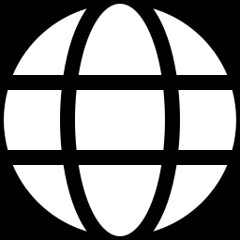
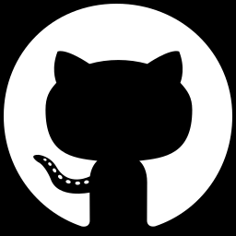
Live demo on the laptop
Browser
index.html and JavaScript
GroceryWeb
Java HttpServer, /api routes
GroceryStore
Product, Cart, Customer objects
Demo steps
Browse products and filter by type
Add rice, then try more than the stock
Open the cart and check the total
Pay and watch the stock drop
Local site
http://localhost:8080
GitHub
[repository link]
Notes:
About 3 minutes. Start the server on the laptop with java GroceryShop before presenting, then open http://localhost:8080 in the browser. Follow the four demo steps. Mention that the same Java classes also run in a console version (java GroceryShop console).

Slide 15
Conclusion
What we built
Next steps
Accurate billing and live stock checks
A clean OOP design with five UML diagrams
The same classes serve a console app and a local website
Save data in a database or files
Add admin login and stock updates
Add online payment and order history
Thank you. Questions?
Notes:
About 1 minute. Summarise the three results, then the next steps: a database for permanent data, an admin panel, and payments. Invite questions and offer to run the demo again.

